Slide 1


What Artificial Intelligence Is
01
PART I · FOUNDATIONS OF INTELLIGENT SYSTEMS
CHAPTER 1 · WEEK 1
Artificial Intelligence — Search, Knowledge and Reasoning
LECTURER
Dr. Mustafa Hameed
THE ISLAMIA UNIVERSITY OF BAHAWALPUR
Bahawalpur, Pakistan
Department of Information Technology · BSIT · Fall 2026
Notes:
Chapter 1: What Artificial Intelligence Is. Part 1 — Foundations of Intelligent Systems. Week 1: What AI is; intelligent agents and task environments. Handout pages 3–12.

Slide 2

Where this chapter sits
THE COURSE
PART I
PART II
PART III
PART IV
PART V
PART VI
1
2
3
4
5
6
7
8
9
10
11
12
13
14
15
16
17
18
19
20
21
22
What Artificial Intelligence Is
BUILDS ON
USED LATER IN
— nothing earlier in the course
Ch 2 Intelligent Agents and Task Environments
Ch 4 Problem Formulation and Uninformed Search
Ch 9 Planning
Ch 10 Knowledge Representation
Ch 17 Learning from Examples
Artificial Intelligence · Chapter 1 · What Artificial Intelligence Is
Handout p. 3 2
Notes:
Place the chapter. Before you start: Object Oriented Programming, the published prerequisite for this course: classes, objects, inheritance, collections and recursion. No mathematics beyond school algebra is assumed in this chapter. Appendix A is a reference for every Python construct the labs use.

Slide 3

What you will be able to do
LEARNING OUTCOMES
By the end of this chapter you will be able to:
1
Define artificial intelligence, and distinguish the four classical definitions along the two axes of thinking versus acting and humanly versus rationally.
2
Identify whether a given piece of software is an AI system, by applying a five-point test rather than by reputation.
3
Name the branches of AI and say which of them this course teaches, which it signposts, and which belong to other courses.
4
Describe the field’s history as a sequence of promises, disappointments and recoveries, and explain what caused each turn.
5
State the boundary between artificial intelligence, machine learning and data science in terms of what each one is given and what each one must work out for itself.
Artificial Intelligence · Chapter 1 · What Artificial Intelligence Is
Handout p. 3 3
Notes:
Read these out: they are the chapter's contract with the room. Each click adds one.

Slide 4

Vocabulary for this chapter
KEY TERMS
artificial intelligence
agent
percept
action
rationality
the Turing test
symbolic AI
knowledge representation
search
heuristic
combinatorial explosion
weak and strong AI
narrow and general AI
AI winter
expert system
Each term is defined where it first matters — not here.
Artificial Intelligence · Chapter 1 · What Artificial Intelligence Is
Handout p. 3 4
Notes:
Do not define these now; they arrive one at a time. This slide is for the students' notes. Terms: artificial intelligence; agent; percept; action; rationality; the Turing test; symbolic AI; knowledge representation; search; heuristic; combinatorial explosion; weak and strong AI; narrow and general AI; AI winter; expert system.

Slide 5

In this chapter
IN THIS CHAPTER
1.1
Two Programs in a Project Office
p. 3 ›
1.2
Four Definitions, Two Axes
p. 4 ›
1.3
Is It AI? A Checklist
p. 5 ›
1.4
The Branches of AI
p. 6 ›
1.5
Sixty Years in Five Waves
p. 6 ›
1.6
What This Course Teaches, and What It Does Not
p. 8 ›
Artificial Intelligence · Chapter 1 · What Artificial Intelligence Is
Handout pp. 3–12 5
Notes:
The route through the chapter. Each row is a link: click it to jump to that section in the slide show.

Slide 6

Artificial intelligence
DEFINITION
Artificial intelligence is the study and construction of agents: programs that perceive an environment through percepts and act on it through actions, choosing those actions so as to do well by some measure of success. The central question of the field is not “can a machine think?” but “given what it can perceive, what should this agent do next?”
After S. Russell and P. Norvig, Artificial Intelligence: A Modern Approach, 3rd edition, Prentice Hall, 2010 — the set text for this course in both the HEC 2017 and HEC 2023 outlines.
Artificial Intelligence · Chapter 1 · What Artificial Intelligence Is
§1.1 · Handout p. 3 6
Notes:
A software house runs its delivery work out of a project management office. Two programs run there every night. The first recalculates the Gantt chart. It is given the task list, each task’s duration and each task’s predecessors, and it computes the earliest start and latest finish of every task, the critical path, and the float on everything off it. It is a few hundred lines long, it is completely deterministic, and if it ever disagrees with a hand calculation the program is wrong. Nobody in the office calls it intelligent. The second decides which of tonight’s three hundred open tickets to escalate to the on-call engineer. It is given the tickets, the service level agreements, who is on shift, what each engineer has already been handed, and a history of which escalations turned out to have been worth making. There is no formula in the brief. Two reasonable people, given the same three hundred tickets, would escalate different ones and each could defend the choice. The program has to decide anyway, tonight, before midnight. That difference — not the difficulty of the arithmetic, not the size of the codebase, and not the fashionability of the technique — is what this book is about. The first program computes an answer that was already implied by its input. The second must work out what to do when its input does not determine the answer.

Slide 7
Four Definitions, Two Axes
SECTION 2 OF 6
1.2
1.1 Two Programs in a Project Office
1.2 Four Definitions, Two Axes
1.3 Is It AI? A Checklist
1.4 The Branches of AI
1.5 Sixty Years in Five Waves
1.6 What This Course Teaches, and What It Does Not
Artificial Intelligence · Chapter 1
Handout §1.2 7
Notes:
Pause. Name the question this section answers.

Slide 8
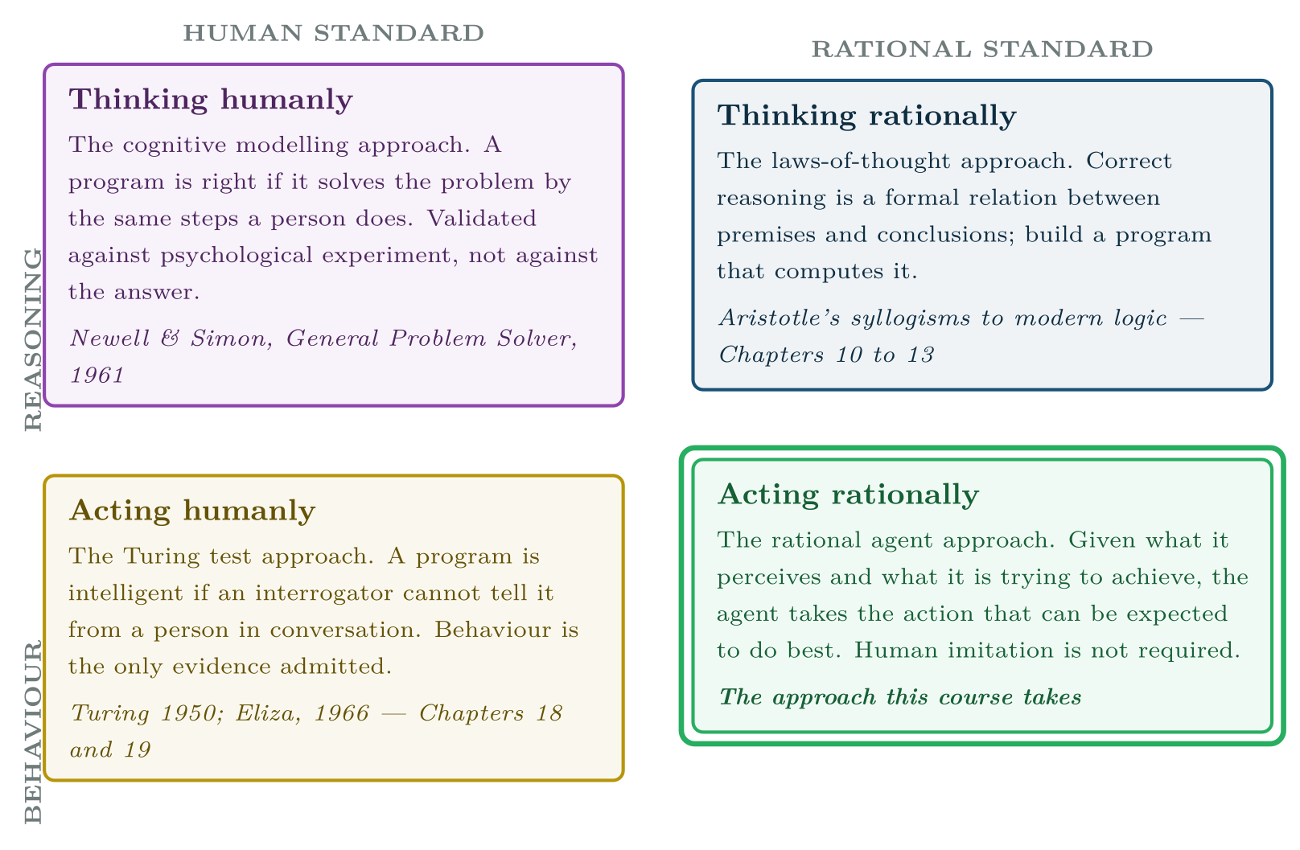
Four Definitions, Two Axes
FIGURE 1.1
The four classical definitions of artificial intelligence, on the two axes of thought against behaviour and human performance against rational performance. This course works in the bottom-right quadrant throughout.
Artificial Intelligence · Chapter 1 · What Artificial Intelligence Is
§1.2 · Handout p. 4 8
Notes:
The definition is deliberately modest. It says nothing about consciousness, nothing about brains, and nothing about whether the agent’s reasoning resembles ours. It asks only that the agent take in a situation and choose. Everything in this course is machinery for making that choice: search when the agent must look ahead (Chapters 4 to 6), constraint reasoning when the choice must satisfy rules at once (Chapter 7), game reasoning when another agent is choosing against you (Chapter 8), planning when the choice is a sequence (Chapter 9), logic when the agent must draw conclusions from what it has been told (Chapters 10 to 13), and probability when what it has been told is not certain (Chapters 14 to 16). The field has never had one definition. It has had four, and they differ along two axes: whether the goal is to replicate thought or to produce the right behaviour, and whether the standard of correctness is human performance or an ideal standard of rationality. Figure 1.1 sets them out.
Figure 1.1 (handout p. 4): The four classical definitions of artificial intelligence, on the two axes of thought against behaviour and human performance against rational performance. This course works in the bottom-right quadrant throughout.

Slide 9

Four Definitions, Two Axes
CONCEPT
The four quadrants are not four opinions about the same question; they are four different questions, and they license different evidence. If your goal is acting humanly, then a program that answers a service-desk query the way a tired engineer would — including the shortcuts — is a success. If your goal is acting rationally, the same program is a failure, because the tired engineer was wrong.
This matters in practice, and the practical consequence is this: decide which quadrant you are in before you choose your evaluation. Chapter 19 shows Eliza, a program that is a triumph in the bottom-left quadrant and worthless in the bottom-right, and the difference is not in the code.
Artificial Intelligence · Chapter 1 · What Artificial Intelligence Is
§1.2 · Handout p. 4 9
Notes:
Read the box aloud, then ask for an example from the room before moving on.

Slide 10
Is It AI? A Checklist
SECTION 3 OF 6
1.3
1.1 Two Programs in a Project Office
1.2 Four Definitions, Two Axes
1.3 Is It AI? A Checklist
1.4 The Branches of AI
1.5 Sixty Years in Five Waves
1.6 What This Course Teaches, and What It Does Not
Artificial Intelligence · Chapter 1
Handout §1.3 10
Notes:
Pause. Name the question this section answers.

Slide 11
Is It AI? A Checklist
IN BRIEF
1. Goal. Is the program given an objective rather than a procedure? A program told minimise the number of breached service level agreements has a goal. A program told sort the tickets by deadline, then assign the first ten has a procedure.
2. Search. Does it consider alternatives it does not act on? An agent that generates candidate assignments, evaluates them and picks one has searched. An agent that computes one answer directly has not.
3. Knowledge. Does it hold an explicit, inspectable representation of its domain — facts, rules, constraints, a probability model — that a domain expert could read and correct without editing the algorithm?
4. Adaptation. Does its behaviour change with experience, without being reprogrammed?
5. Explanation. Can it say why? Can it produce the chain of facts and inferences that led to its answer?
Artificial Intelligence · Chapter 1 · What Artificial Intelligence Is
§1.3 · Handout p. 5 11
Notes:
“Artificial intelligence” is now a procurement word. Vendors apply it to spreadsheet macros, and sceptics withhold it from systems that plainly reason. The HEC outline asks you to be able to identify AI systems, which means having a test you can apply to software you did not write. Here is one. Five questions; score each one and count.

Slide 12

Five tools in one project office
EXAMPLE
Scores on the five tests of Section 1.3, for the five programs the office actually runs. This is the audit the chapter’s lab reproduces in code.
Program | Goal | Srch | Know | Adapt | Expl | Score
Gantt recalculator | — | — | — | — | — | 0
Burndown chart generator | — | — | — | — | — | 0
Sprint scheduler | yes | yes | yes | — | yes | 4
Escalation adviser | yes | yes | yes | — | yes | 4
Duplicate-ticket finder | — | — | — | yes | — | 1
The two zeroes are not failures; they are the right tools for questions that have formulas. The sprint scheduler is Chapter 7, the escalation adviser is Chapter 13, and the duplicate finder is the one tool of the five that this course hands to Chapter 17 and then to Machine Learning.
Artificial Intelligence · Chapter 1 · What Artificial Intelligence Is
§1.3 · Handout p. 5 12
Notes:
A program scoring zero is ordinary software, however valuable. A program scoring one or two is doing something interesting. Three or more, and the vocabulary of this course is the right vocabulary for talking about it. Two warnings about the test. First, it is not a quality measure: a badly built system can score five, and the Gantt recalculator that scores zero is the most useful program in the office. Second, question 4 is neither necessary nor sufficient. Much of the most successful AI ever built — the chess programs of Chapter 8, the schedulers of Chapter 7, the diagnostic systems of Chapter 13 — scores zero on adaptation. Learning is one route to intelligent behaviour, not its definition. That is worth saying plainly at the start of a course that will spend fifteen weeks on the other routes.

Slide 13
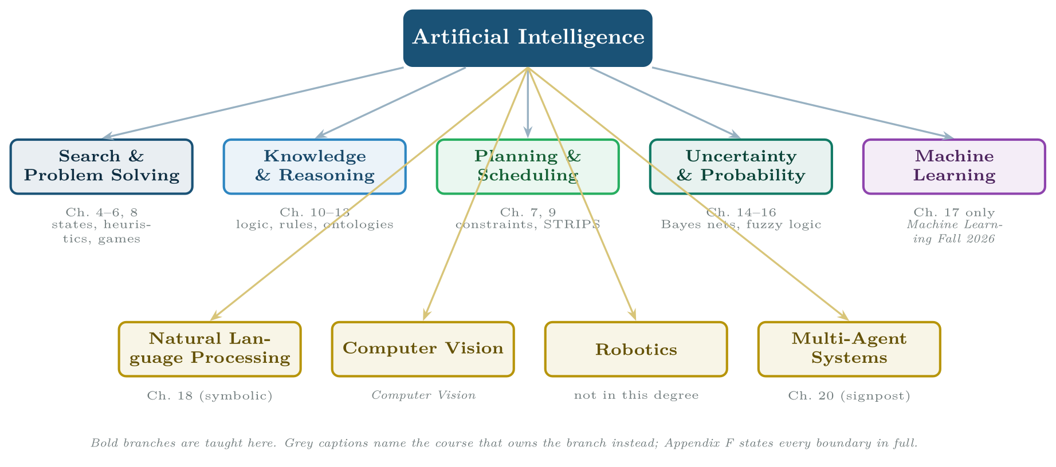
The branches of artificial intelligence, and which of them this course teaches
FIGURE 1.2
The five branches on the upper row are the body of the course; the lower row is covered by a signpost chapter or by another course entirely.
Artificial Intelligence · Chapter 1 · What Artificial Intelligence Is
§1.4 · Handout p. 6 13
Notes:
The field is conventionally divided as in Figure 1.2. The division is untidy, because the branches are not disjoint — planning uses search, natural language processing uses both logic and probability — but it is the division the HEC outline uses and the one job advertisements use.
Figure 1.2 (handout p. 6): The branches of artificial intelligence, and which of them this course teaches. The five branches on the upper row are the body of the course; the lower row is covered by a signpost chapter or by another course entirely.

Slide 14
Sixty Years in Five Waves
SECTION 5 OF 6
1.5
1.1 Two Programs in a Project Office
1.2 Four Definitions, Two Axes
1.3 Is It AI? A Checklist
1.4 The Branches of AI
1.5 Sixty Years in Five Waves
1.6 What This Course Teaches, and What It Does Not
Artificial Intelligence · Chapter 1
Handout §1.5 14
Notes:
Pause. Name the question this section answers.

Slide 15

Sixty Years in Five Waves
AT A GLANCE
Period | What was achieved | Why it stalled
Period | What was achieved | Why it stalled
1943–1956 Foundations | McCulloch and Pitts’ artificial neuron; Turing’s 1950 paper and his test; the 1956 Dartmouth workshop, which named the field. | Nothing stalled yet. The founding claim — that every aspect of intelligence could be “so precisely described that a machine can be made to simulate it” — set the expectations that the next twenty years failed to meet.
1956–1974 Search and the general solver | The Logic Theorist and the General Problem Solver (Chapter 9); Samuel’s checkers player; Eliza (Chapter 18); early perceptrons (Chapter 17). | Combinatorial explosion. The methods worked on toy problems and died on real ones: a search that is fine at depth 6 is hopeless at depth 20. Minsky and Papert’s 1969 analysis of the perceptron’s limits closed the neural line for fifteen years.
1974–1980 First winter | — | The Lighthill report (1973) in the UK and DARPA’s withdrawal in the US ended general AI funding. The diagnosis was correct: the field had solved the easy half of its problems and called it progress.
1980–1987 Expert systems | Knowledge, not cleverness, as the engine: MYCIN, XCON, and a commercial industry in rule-based systems (Chapter 13). Japan’s Fifth Generation project. | The knowledge acquisition bottleneck. Rules had to be elicited from experts one at a time, could not be learned, grew brittle at a few thousand rules, and degraded catastrophically rather than gracefully at the edge of their competence.
Artificial Intelligence · Chapter 1 · What Artificial Intelligence Is
§1.5 · Handout p. 6 15
Notes:
AI has a distinctive history: repeated cycles in which a genuine advance is over-promised, fails to generalise, and is followed by a collapse in funding severe enough to have earned its own name, an AI winter. Knowing the shape of the cycle is professionally useful, because it is happening again now and you will be asked to make judgements inside it.

Slide 16
Sixty Years in Five Waves (continued)
AT A GLANCE
Period | What was achieved | Why it stalled
1987–1993 Second winter | — | The specialised hardware market collapsed; “AI” became a word firms avoided in prospectuses. The research continued under other names — “knowledge-based systems”, “decision support”.
1993–2011 The quiet, successful period | The rational-agent reframing that this course follows; probability and Bayesian networks (Chapter 15); Deep Blue (1997); statistical machine translation; search engines and recommenders. AI methods everywhere, under other names. | It did not stall. It stopped claiming to be AI, which is why this era is the least famous and the most useful.
2012–present Learning at scale | Deep networks, then transformers and large language models; systems that write fluent text and usable code (Chapter 20). | Still open. The symbolic questions this course teaches — can it prove it, can it explain it, can it guarantee the constraint holds — are exactly the ones the current wave answers least well (Chapter 21).
Artificial Intelligence · Chapter 1 · What Artificial Intelligence Is
§1.5 · Handout p. 6 16
Notes:
Do not read the table row by row: pick the row the room is most likely to get wrong and ask why.

Slide 17

The pattern worth taking from the history
WATCH OUT
Every winter arrived the same way: a method that worked at small scale was sold as a method that worked, and the gap was discovered by customers rather than by researchers. The methods themselves were not discredited — minimax, resolution and rule engines are all in production today, in this book’s Chapters 8, 12 and 13. What was discredited each time was a claim about their reach.
You will be asked to make that kind of claim in your own career, probably about something you built over a weekend that worked beautifully on twenty examples. Chapter 21 gives you the vocabulary to make it honestly.
Artificial Intelligence · Chapter 1 · What Artificial Intelligence Is
§1.5 · Handout p. 6 17
Notes:
Read the box aloud, then ask for an example from the room before moving on.

Slide 18
What This Course Teaches, and What It Does Not
SECTION 6 OF 6
1.6
1.1 Two Programs in a Project Office
1.2 Four Definitions, Two Axes
1.3 Is It AI? A Checklist
1.4 The Branches of AI
1.5 Sixty Years in Five Waves
1.6 What This Course Teaches, and What It Does Not
Artificial Intelligence · Chapter 1
Handout §1.6 18
Notes:
Pause. Name the question this section answers.

Slide 19
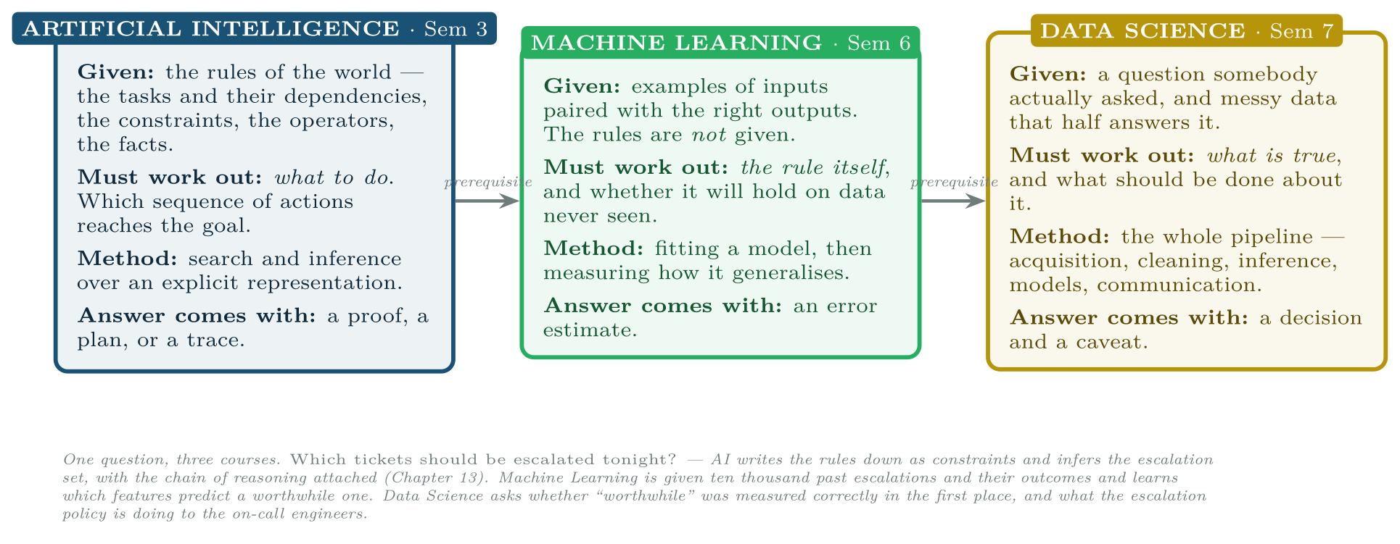
What This Course Teaches, and What It Does Not
FIGURE 1.3
Artificial intelligence, machine learning and data science, separated by what each is given and what each must work out. The distinction is not the technique; it is where the rules come from.
Artificial Intelligence · Chapter 1 · What Artificial Intelligence Is
§1.6 · Handout p. 8 19
Notes:
Artificial intelligence, machine learning and data science are three courses in this degree, taught in that order, and students routinely confuse them because all three are described in job advertisements with the same six words. Figure 1.3 draws the boundary in a way that survives contact with a real question, and Appendix F states it chapter by chapter.
Figure 1.3 (handout p. 8): Artificial intelligence, machine learning and data science, separated by what each is given and what each must work out. The distinction is not the technique; it is where the rules come from.

Slide 20

Auditing one tool against the five tests
WORKED EXAMPLE
The office’s duplicate-ticket finder takes each new ticket and flags the three existing tickets most similar to it, so the service desk can merge them. Its similarity measure is tuned monthly against the merges the desk actually made. Score it.
1. Goal? No. The brief is a procedure: compute similarity, return the top three. There is no objective it is trying to do well by; if the desk wanted the top five it would be a different program.
2. Search? No. It scores every candidate and returns the best three. Scoring all alternatives and ranking them is not search — there is no point at which the program commits to a partial choice and explores its consequences. Compare Chapter 4, where a decision about task 3 changes which states are reachable at all.
Artificial Intelligence · Chapter 1 · What Artificial Intelligence Is
§1.6 · Handout p. 8 20
Notes:
So: this course is symbolic. It teaches the agent that is told the rules and must reason with them. That is not a historical curiosity, for three reasons. It is where guarantees live — a constraint solver can prove no engineer is double-booked, and no learned model can (Chapter 7). It is where explanations live — a rule engine can print the chain that produced its answer, and that chain is what an auditor accepts (Chapter 13). And it is where you go when you have no data, which is the situation at the start of every new project. Chapter 17 is the one chapter about learning. It covers the three paradigms the HEC 2017 outline names, works the perceptron numerically, shows why a single perceptron cannot represent exclusive-or — the result that caused the first neural winter — and then stops and hands over. It is a signpost, not a unit.
Each click adds one step of the working. Ask for the next number before you reveal it.

Slide 21
Auditing one tool against the five tests (continued)
WORKED EXAMPLE
3. Knowledge? No. The similarity weights are numbers in a configuration file. A service-desk manager cannot read them and say “that is wrong, a database timeout is not like a login failure”.
4. Adaptation? Yes. Behaviour changes monthly on the evidence of past merges, with nobody editing the code.
5. Explanation? No. It reports a similarity score. A score is a number, not a reason.
Score: 1 of 5 — and the one point is adaptation, the single test that this course does not teach. That is the correct verdict, and the useful one: the duplicate finder is a good tool and it is not an AI problem in the sense of this course. It is the machine learning course’s problem. Contrast the sprint scheduler, which scores 4 and whose one missing point is adaptation.
Artificial Intelligence · Chapter 1 · What Artificial Intelligence Is
§1.6 · Handout p. 8 21
Notes:
Each click adds one step of the working. Ask for the next number before you reveal it.

Slide 22

Common pitfalls
COMMON PITFALLS
✕
Treating “AI” as a synonym for “machine learning”. It is the most common error in this subject, and it makes whole categories of problem invisible. If a constraint must never be violated, no amount of training data is the answer; you need Chapter 7.
✕
Reading the four quadrants of Figure 1.1 as a ranking. They are different goals with different evidence. A program can be excellent in one and worthless in the neighbouring one.
✕
Assuming a program that scores well on the checklist is a good program. The checklist identifies the kind of system, not its quality. The highest-scoring system in an office can be the one that should be deleted.
✕
Believing the winters were caused by the methods failing. Minimax, resolution and rule engines all still work and are all still deployed. What failed was a claim about how far they reached.
✕
Calling a system “general” AI because it is fluent. Fluency is the bottom-left quadrant — acting humanly. Chapter 19’s Eliza is two hundred lines long and was mistaken for a therapist in 1966.
Artificial Intelligence · Chapter 1 · What Artificial Intelligence Is
§1.6 · Handout p. 8 22
Notes:
For each pitfall, ask who has seen it happen. One real story beats five bullets.

Slide 23

Try it yourself: Is It AI? A Five-Point Audit
TRY IT YOURSELF
The audit of the examplebox above, in code. Five tools from the project management office, five tests, one verdict each. Pure standard library: the point of this lab is the classification, not the computation.
THIS WEEK'S LAB
WHAT YOU WILL RUN
RUNNABLE COPY
Week 1: Is it AI? a five-point audit; a reflex agent on a ticket queue
1 listing, 84 lines of Python
code/ch01_is_it_ai_five_point.py
Artificial Intelligence · Chapter 1 · What Artificial Intelligence Is
§1.6 · Handout p. 8 23
Notes:
The audit of the examplebox above, in code. Five tools from the project management office, five tests, one verdict each. Pure standard library: the point of this lab is the classification, not the computation.

Slide 24
Is It AI? A Five-Point Audit
LAB · STEP 1 OF 5
Python · code/ch01_is_it_ai_five_point.py
2
3
4
5
6
7
8
9
10
"""Chapter 1 lab -- Is it AI? A five-point audit.
Score five programs from a project management office against the five
tests of Section 1.3, and classify each one. Nothing here learns
anything; the exercise is to separate programs that decide from
programs that compute.
"""
TESTS = ("goal", "search", "knowledge", "adapts", "explains")
Artificial Intelligence · Chapter 1 · What Artificial Intelligence Is
§1.6 · Handout p. 8 24
Notes:
Read the code aloud; ask what each line would print before running it.

Slide 25
Is It AI? A Five-Point Audit
LAB · STEP 2 OF 5
Python · code/ch01_is_it_ai_five_point.py
12
13
14
15
16
17
18
19
20
21
22
23
24
25
26
27
28
29
30
31
# One row per tool: which of the five tests it passes, and why the
# most interesting answer is what it is.
TOOLS = {
"Gantt recalculator": {
"passes": (),
"note": "given a procedure, not an objective; one answer, "
"computed directly",
},
"Burndown chart generator": {
"passes": (),
"note": "arithmetic and a plot; no alternatives considered",
},
"Sprint scheduler": {
"passes": ("goal", "search", "knowledge", "explains"),
"note": "constraints are declared, not coded; reports which "
"constraint blocked a story (Chapter 7)",
},
"Escalation adviser": {
"passes": ("goal", "search", "knowledge", "explains"),
"note": "rules an operations lead can read and correct; prints "
Artificial Intelligence · Chapter 1 · What Artificial Intelligence Is
§1.6 · Handout p. 8 25
Notes:
Read the code aloud; ask what each line would print before running it.

Slide 26
Is It AI? A Five-Point Audit
LAB · STEP 3 OF 5
Python · code/ch01_is_it_ai_five_point.py
32
33
34
35
36
37
38
39
40
41
42
43
44
45
46
47
48
"its firing chain (Chapter 13)",
},
"Duplicate-ticket finder": {
"passes": ("adapts",),
"note": "weights retuned monthly from past merges; the one "
"tool here that belongs to Machine Learning",
},
}
def verdict(score):
"""The reading of a score given in Section 1.3."""
if score == 0:
return "ordinary software"
if score <= 2:
return "doing something interesting"
return "an AI system"
Artificial Intelligence · Chapter 1 · What Artificial Intelligence Is
§1.6 · Handout p. 8 26
Notes:
Read the code aloud; ask what each line would print before running it.

Slide 27
Is It AI? A Five-Point Audit
LAB · STEP 4 OF 5
Python · code/ch01_is_it_ai_five_point.py
51
52
53
54
55
56
57
58
59
60
61
62
63
64
65
def audit():
width = max(len(name) for name in TOOLS)
head = "TOOL".ljust(width) + " " + " ".join(
t[:4].upper().rjust(5) for t in TESTS) + " SCORE VERDICT"
print(head)
print("-" * len(head))
for name, row in TOOLS.items():
marks = ["yes".rjust(5) if t in row["passes"] else "-".rjust(5)
for t in TESTS]
score = len(row["passes"])
print(name.ljust(width) + " " + " ".join(marks) +
" %5d %s" % (score, verdict(score)))
print()
for name, row in TOOLS.items():
print("%s\n %s" % (name, row["note"]))
Artificial Intelligence · Chapter 1 · What Artificial Intelligence Is
§1.6 · Handout p. 8 27
Notes:
Read the code aloud; ask what each line would print before running it.

Slide 28
Is It AI? A Five-Point Audit
LAB · STEP 5 OF 5
Python · code/ch01_is_it_ai_five_point.py
68
69
70
71
72
73
74
75
76
77
78
79
80
81
82
83
84
85
def check():
"""The two claims the chapter makes about this table."""
scores = {n: len(r["passes"]) for n, r in TOOLS.items()}
# Adaptation is the only test the AI systems here fail ...
for name in ("Sprint scheduler", "Escalation adviser"):
assert "adapts" not in TOOLS[name]["passes"], name
assert scores[name] == 4, name
# ... and the only test the machine learning tool passes.
assert TOOLS["Duplicate-ticket finder"]["passes"] == ("adapts",)
print("\nchecks passed: intelligent behaviour here does not "
"require learning,")
print("and the one tool that learns is the one this course "
"hands on.")
if __name__ == "__main__":
audit()
check()
Artificial Intelligence · Chapter 1 · What Artificial Intelligence Is
§1.6 · Handout p. 8 28
Notes:
Read the code aloud; ask what each line would print before running it.

Slide 29
What the lab shows
TRY IT YOURSELF
Now add a sixth tool of your own — something you have actually used, a CI pipeline or an IDE’s autocomplete — and score it. The interesting cases are the ones that score 2 or 3: write down which test you were least sure about and why.
Artificial Intelligence · Chapter 1 · What Artificial Intelligence Is
§1.6 · Handout p. 8 29
Notes:
Read the box aloud, then ask for an example from the room before moving on.

Slide 30

A program is given the sentence minimise total project delay and a list of tasks with durations and dependencies. Which of the five tests of Section 1.3 does it pass on that description alone, and which cannot be judged until you see the implementation?
CHECKPOINT 1 OF 3
Discuss with the person next to you, then advance.
Artificial Intelligence · Chapter 1 · What Artificial Intelligence Is
Handout p. 12 · answers in Appendix D 30
Notes:
Ask the room. Do not advance until someone commits to an answer.

Slide 31

A program is given the sentence minimise total project delay and a list of tasks with durations and dependencies. Which of the five tests of Section 1.3 does it pass on that description alone, and which cannot be judged until you see the implementation?
CHECKPOINT 1 OF 3 · ANSWER
Goal is passed on the description alone: “minimise total project delay” is an objective, not a procedure. Knowledge is arguably passed too — the task list with durations and dependencies is an explicit, inspectable representation that a delivery manager could correct without touching the algorithm. Search, adaptation and explanation cannot be judged without seeing the implementation: a program with this brief might enumerate alternatives or might compute one critical path directly, and the description does not say.
Artificial Intelligence · Chapter 1 · What Artificial Intelligence Is
Handout p. 12 · answers in Appendix D 31
Notes:
Answer (Appendix D): Goal is passed on the description alone: “minimise total project delay” is an objective, not a procedure. Knowledge is arguably passed too — the task list with durations and dependencies is an explicit, inspectable representation that a delivery manager could correct without touching the algorithm. Search, adaptation and explanation cannot be judged without seeing the implementation: a program with this brief might enumerate alternatives or might compute one critical path directly, and the description does not say.

Slide 32
A chatbot answers service-desk questions so convincingly that users believe it is a person, but it has no representation of the service catalogue and cannot say why it gave an answer. Which quadrant of Figure 1.1 is it succeeding in, and which is it failing in?
CHECKPOINT 2 OF 3
Discuss with the person next to you, then advance.
Artificial Intelligence · Chapter 1 · What Artificial Intelligence Is
Handout p. 12 · answers in Appendix D 32
Notes:
Ask the room. Do not advance until someone commits to an answer.

Slide 33
A chatbot answers service-desk questions so convincingly that users believe it is a person, but it has no representation of the service catalogue and cannot say why it gave an answer. Which quadrant of Figure 1.1 is it succeeding in, and which is it failing in?
CHECKPOINT 2 OF 3 · ANSWER
It is succeeding in acting humanly — the bottom-left quadrant, the Turing test standard, where indistinguishability from a person is the whole criterion. It is failing in acting rationally: with no representation of the service catalogue it cannot be relied on to give the right answer, and with no explanation its answers cannot be checked. It is also failing thinking rationally, since there is no inference to inspect. This is exactly the Eliza pattern of Chapter 19.
Artificial Intelligence · Chapter 1 · What Artificial Intelligence Is
Handout p. 12 · answers in Appendix D 33
Notes:
Answer (Appendix D): It is succeeding in acting humanly — the bottom-left quadrant, the Turing test standard, where indistinguishability from a person is the whole criterion. It is failing in acting rationally: with no representation of the service catalogue it cannot be relied on to give the right answer, and with no explanation its answers cannot be checked. It is also failing thinking rationally, since there is no inference to inspect. This is exactly the Eliza pattern of Chapter 19.

Slide 34
The expert-systems boom ended in the knowledge acquisition bottleneck. Name the chapter of this handout that builds an expert system, and state which single one of the five tests such a system fails.
CHECKPOINT 3 OF 3
Discuss with the person next to you, then advance.
Artificial Intelligence · Chapter 1 · What Artificial Intelligence Is
Handout p. 12 · answers in Appendix D 34
Notes:
Ask the room. Do not advance until someone commits to an answer.

Slide 35
The expert-systems boom ended in the knowledge acquisition bottleneck. Name the chapter of this handout that builds an expert system, and state which single one of the five tests such a system fails.
CHECKPOINT 3 OF 3 · ANSWER
Chapter 13 builds one. Such a system fails the adaptation test: its rules are elicited from experts by hand and it does not improve with experience. That is precisely the knowledge acquisition bottleneck which ended the expert-system boom — and note that it fails the one test this course does not teach, while passing the other four.
Artificial Intelligence · Chapter 1 · What Artificial Intelligence Is
Handout p. 12 · answers in Appendix D 35
Notes:
Answer (Appendix D): Chapter 13 builds one. Such a system fails the adaptation test: its rules are elicited from experts by hand and it does not improve with experience. That is precisely the knowledge acquisition bottleneck which ended the expert-system boom — and note that it fails the one test this course does not teach, while passing the other four.

Slide 36

What to take away
CHAPTER SUMMARY
1
An agent perceives an environment and acts on it. Artificial intelligence is the study of choosing those actions well; the field’s question is “what should this agent do next?”.
2
The four classical definitions differ on two axes: thinking against acting, and the human standard against the rational standard. This course works throughout in the acting rationally quadrant.
3
A program is an AI system to the extent that it is given a goal rather than a procedure, considers alternatives, holds an inspectable representation of its domain, adapts, and can explain itself. Three or more of the five, and this course’s vocabulary applies.
4
Learning is one route to intelligent behaviour, not the definition of it. Chess programs, schedulers and diagnostic systems score zero on adaptation and are unambiguously AI.
5
The history is a cycle: a real advance, an over-general claim, a winter. Combinatorial explosion ended the first wave; the knowledge acquisition bottleneck ended the expert-system wave.
Artificial Intelligence · Chapter 1 · What Artificial Intelligence Is
Handout p. 12 36
Notes:
Ask the room to say each takeaway before you reveal it.

Slide 37
What to take away (continued)
CHAPTER SUMMARY
6
Artificial intelligence is given the rules and must work out what to do; machine learning is given examples and must work out the rule; data science is given a question and must work out what is true. This course is the first of the three, and it is symbolic.
Artificial Intelligence · Chapter 1 · What Artificial Intelligence Is
Handout p. 12 37
Notes:
Ask the room to say each takeaway before you reveal it.

Slide 38

Quick check 1 of 4
REVIEW · MULTIPLE CHOICE
A program that beats a grandmaster at chess but cannot learn from its games is:
AI, and scores zero on the adaptation test
A
not AI, because it does not learn
B
AI only in the “thinking humanly” sense
C
D
machine learning
Artificial Intelligence · Chapter 1 · What Artificial Intelligence Is
Handout p. 12 38
Notes:
Take a show of hands for each option before discussing. (The handout does not print MCQ answers.)

Slide 39
Quick check 2 of 4
REVIEW · MULTIPLE CHOICE
The Turing test belongs in which quadrant?
A
thinking humanly
B
thinking rationally
C
acting humanly
D
acting rationally
Artificial Intelligence · Chapter 1 · What Artificial Intelligence Is
Handout p. 12 39
Notes:
Take a show of hands for each option before discussing. (The handout does not print MCQ answers.)

Slide 40
Quick check 3 of 4
REVIEW · MULTIPLE CHOICE
Which ended the first wave of AI research?
A
the knowledge acquisition bottleneck
B
combinatorial explosion
the collapse of the Lisp machine market
C
D
Minsky and Papert’s book alone
Artificial Intelligence · Chapter 1 · What Artificial Intelligence Is
Handout p. 12 40
Notes:
Take a show of hands for each option before discussing. (The handout does not print MCQ answers.)

Slide 41
Quick check 4 of 4
REVIEW · MULTIPLE CHOICE
A system is given the tasks, the dependencies and the objective, and returns a sequence of actions with a proof that no dependency is violated. Which course owns this problem?
A
Artificial Intelligence
B
Machine Learning
C
Data Science
D
Data Mining
Artificial Intelligence · Chapter 1 · What Artificial Intelligence Is
Handout p. 12 41
Notes:
Take a show of hands for each option before discussing. (The handout does not print MCQ answers.)

Slide 42
For your notebook
REVIEW QUESTIONS
SHORT
State the difference between being given a goal and being given a procedure, using two versions of the same ticket-triage requirement as your example.
SHORT
Why is “it adapts” neither necessary nor sufficient for a program to be an AI system? Give one example each way.
SHORT
The expert-system industry collapsed even though rule engines work. Explain what actually failed, and name the chapter of this handout in which you will build one anyway.
APPLIED
Take a piece of software you have used this week. Score it against the five tests, writing one sentence of justification per test, and give the verdict. Then state which single change to the system would raise its score by one — and whether that change would make it better.
Artificial Intelligence · Chapter 1 · What Artificial Intelligence Is
Handout p. 12 42
Notes:
Set these for independent study. Model answers are not printed in the handout.

Slide 43
End of Chapter 1
01
NEXT
READ
Chapter 2 — Intelligent Agents and Task Environments
Handout Chapter 1, pages 3–12
THIS WEEK'S LAB
Is it AI? a five-point audit; a reflex agent on a ticket queue
Artificial Intelligence · Chapter 1 · What Artificial Intelligence Is
43
Notes:
Close. NEXT: Chapter 2 — Intelligent Agents and Task Environments. READ: Handout Chapter 1, pages 3–12. THIS WEEK'S LAB: Is it AI? a five-point audit; a reflex agent on a ticket queue.

